Slide 1
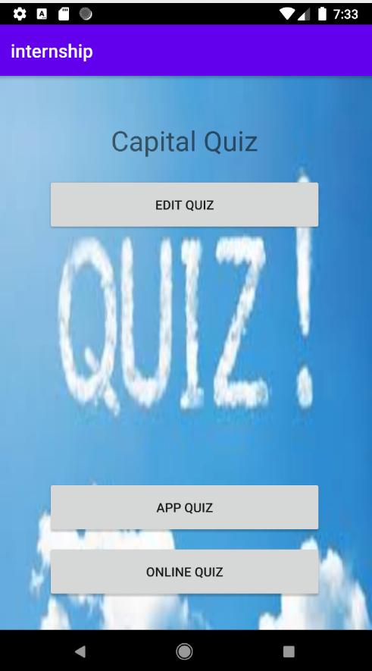
App quiz and Online quiz

Slide 2
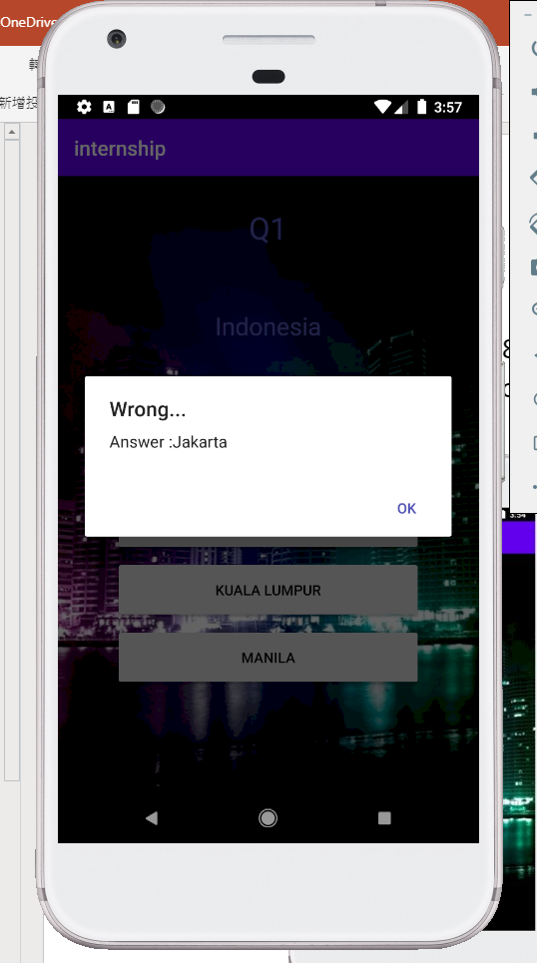
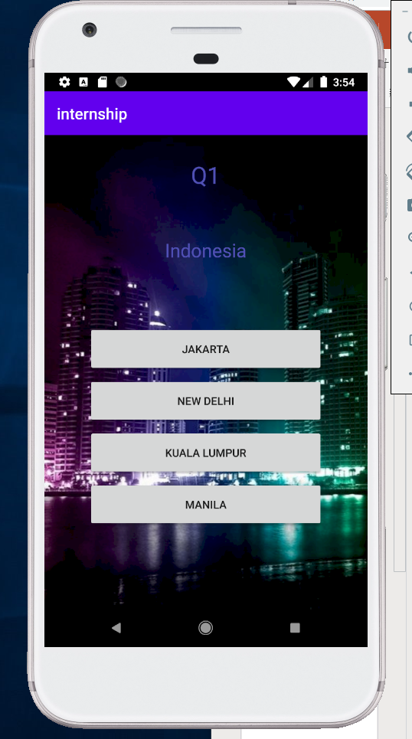
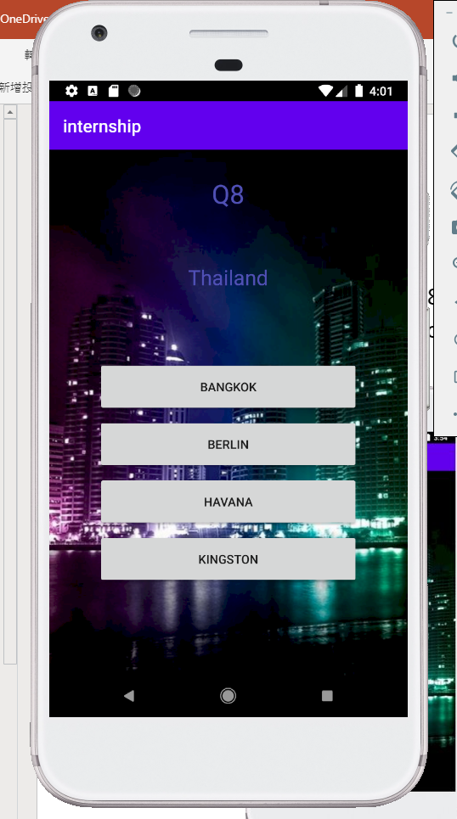
App quiz
Users Click the answers and then the system will display a dialog where the answers is or isn't correct
Question1-Question8
Ask where is the Countries capital

Slide 3
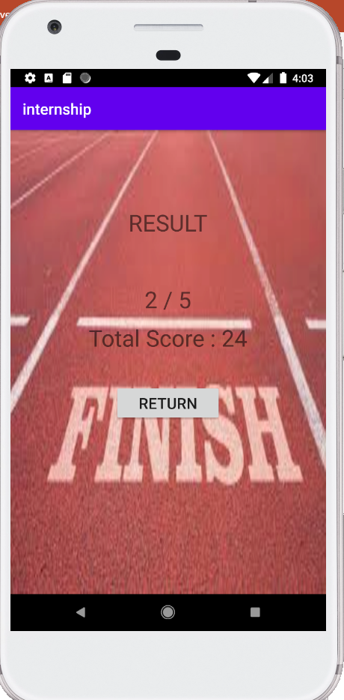
Result
Display the total Score and how many question you are connect
Return button can bring you to the front page(

Slide 4
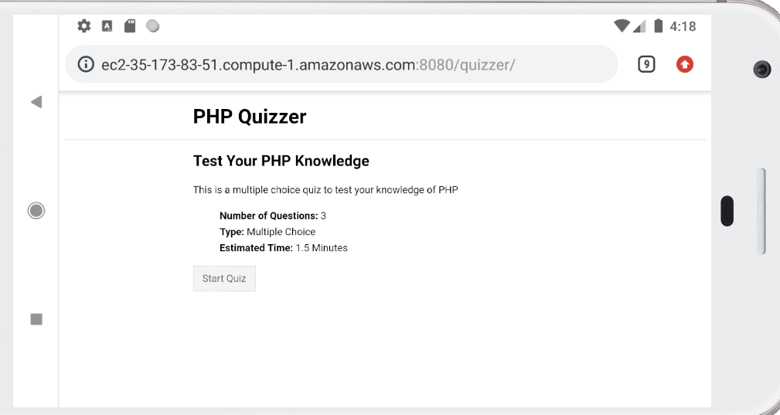
Online quiz
Front page of PHP Qizzer

Slide 5
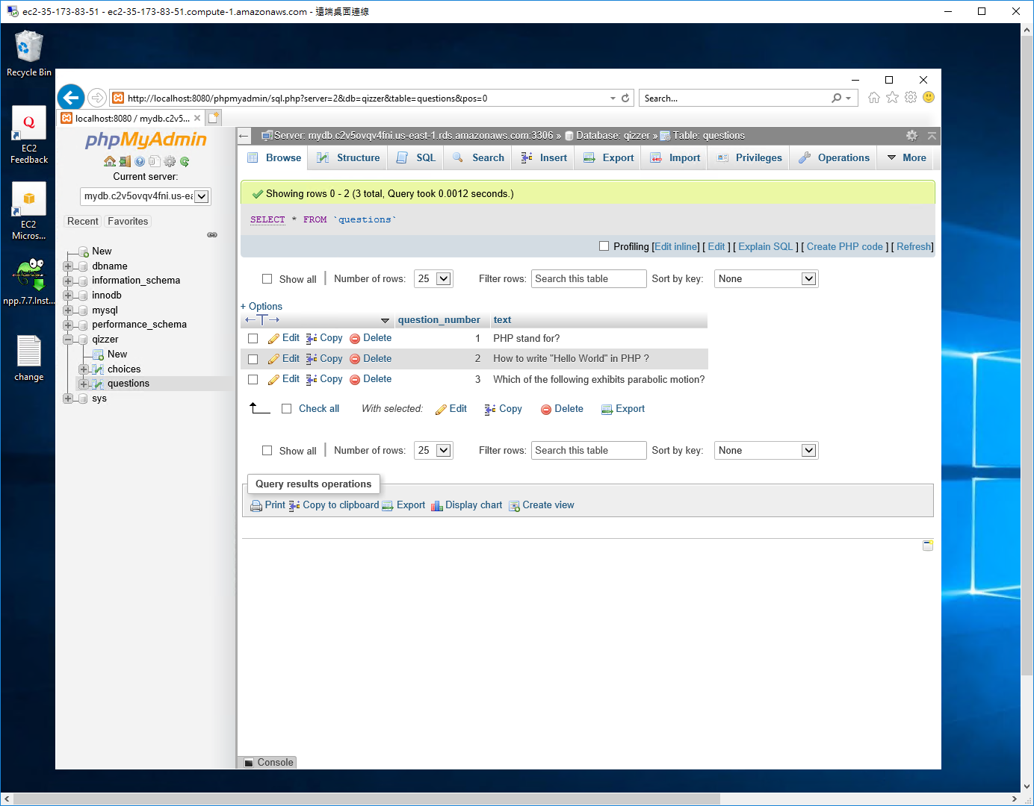
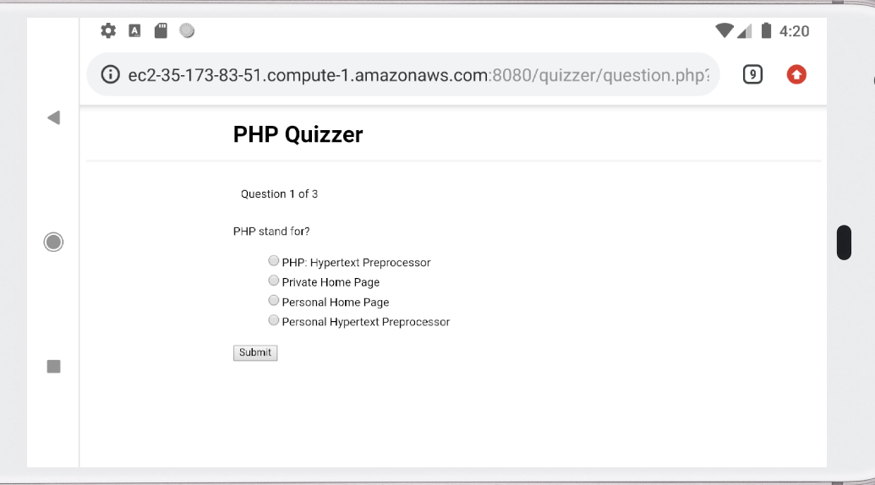
Online quiz
QuestionDatabase
Q1-Q3
4 choices

Slide 6
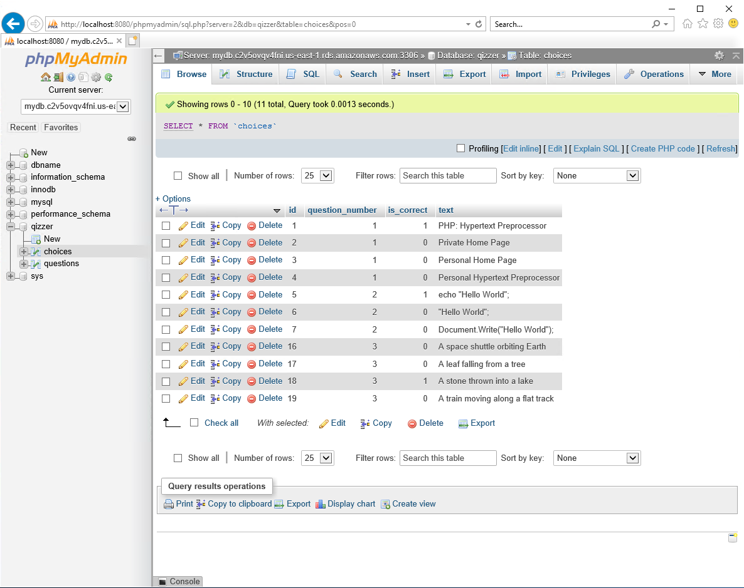
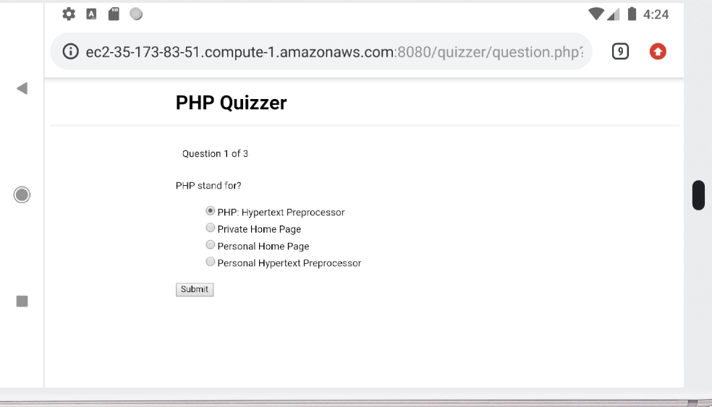
Online quiz
choicesDatabase
Is_corrent colum if number=1 is the answer

Slide 7
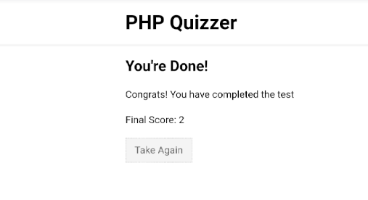
Online quiz
Display Score when you finish
Click Take Again to front

Slide 8
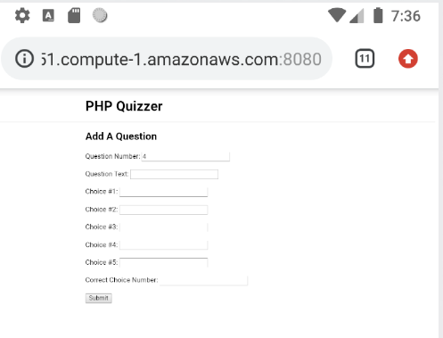
Edit Quiz

Slide 9
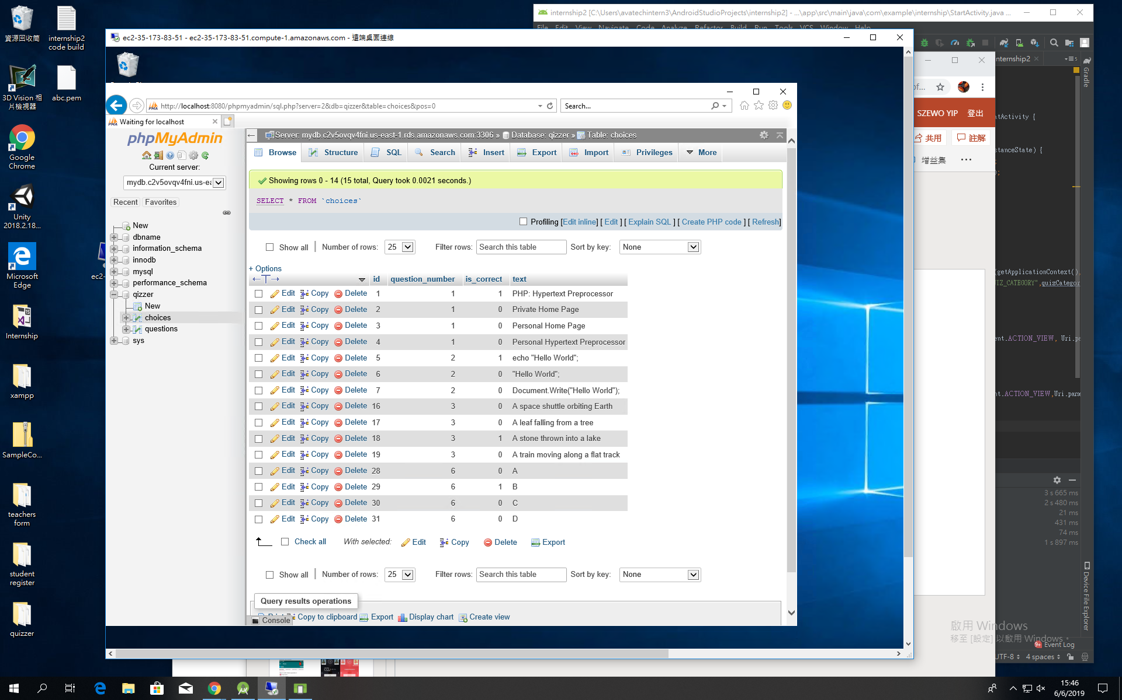
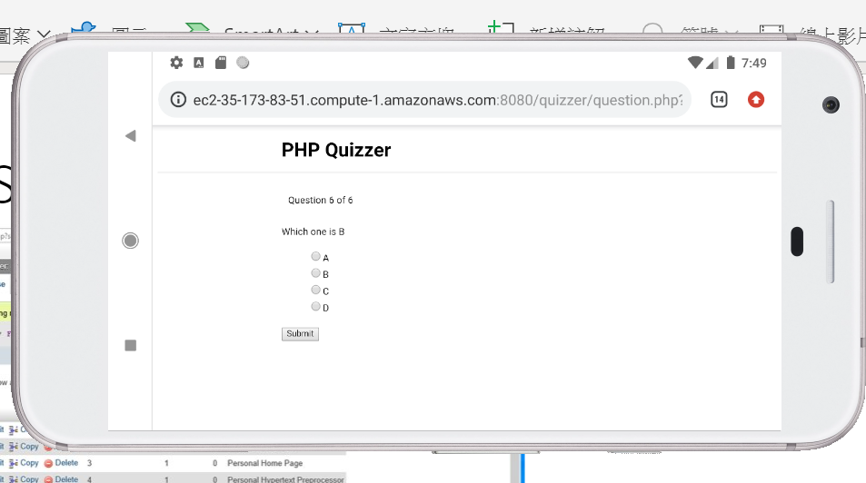
After Submit
WebApp can get the questions from AWS(Cloud)

Slide 10
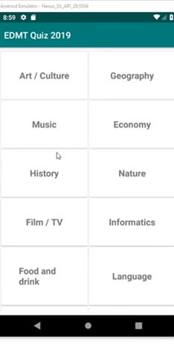
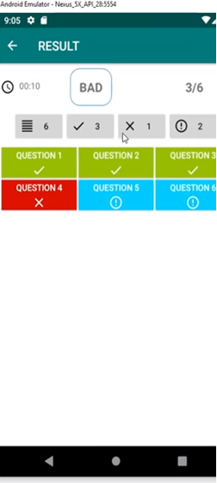
Improvement
View which Question they have answer wrong
Chapter

Slide 11
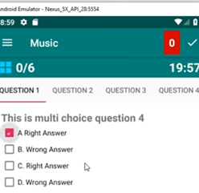
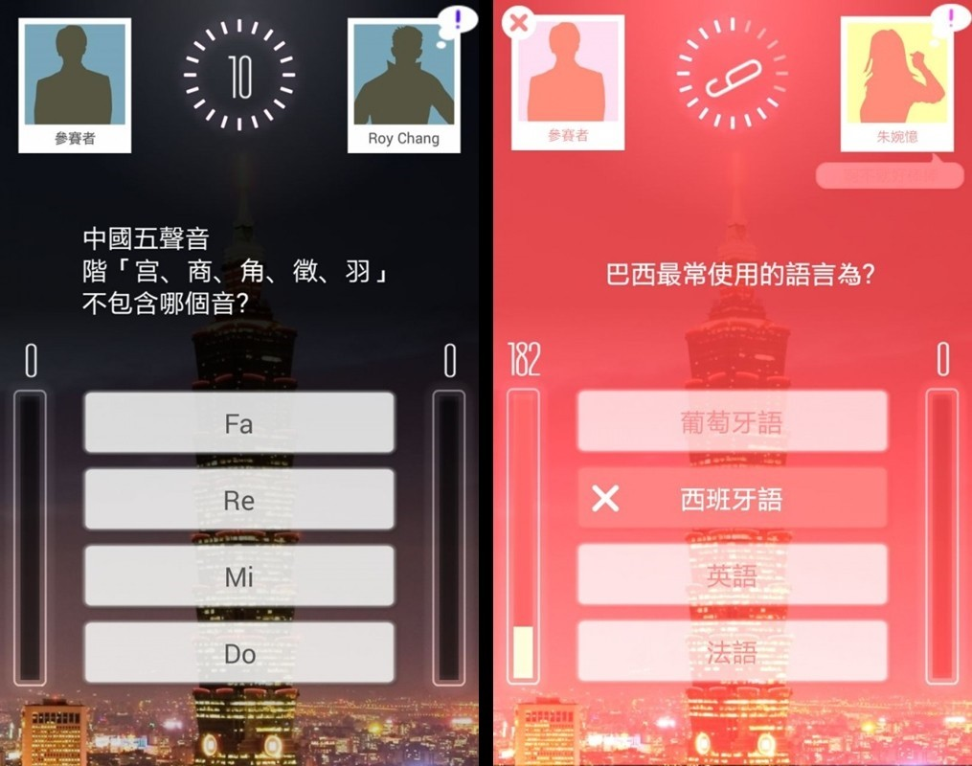
Improvement
Set time limit
Battle System

